Slide 1
Klasifikasi Ruangan di Gedung Pascasarjana PENS
Anggota Kelompok:
Silfiana Nur Hamida (1223800005)
Ambarwati Rizkia Putri (1123800008)
Firnanda Pristiana Nurmaida (1122800004)
Mochamad Riswandha Lazuardi (1123800006)

Slide 2
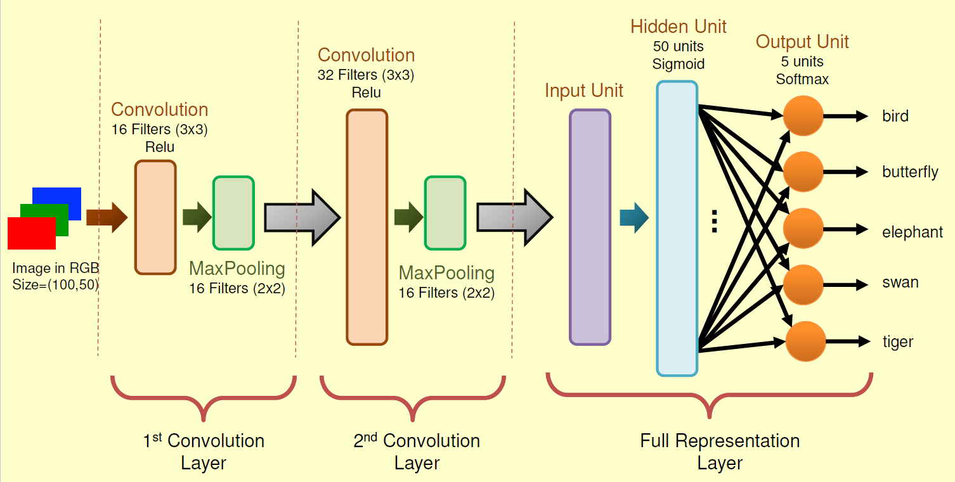
Pendahuluan
Lift
Tangga
Koridor
Toilet
Pintu
Darurat

Slide 3
Melakukan Klasifikasi Gambar
Gambar diklasifikasikan dalam 6 macam, yaitu:
Lift
Tangga
Koridor
Buntu
Toilet
Pintu Darurat
Semua gambar yang didapatkan kemudian dibagi menjadi tiga
bagian, yaitu data training, validation, dan test.

Slide 4
Code
Membuka direktori
%cd /content/drive/MyDrive/CNN_Image4_5
Membaca folder dataset
import os
base_dir = "/content/drive/MyDrive/CNN_Image4_5/dataset"
train_dir = os.path.join(base_dir, 'train')
validation_dir = os.path.join(base_dir, 'validation')
test_dir = os.path.join(base_dir, 'test')
folders=os.listdir(train_dir)

Slide 5
Melakukan preprocessing gambar dengan menggunakan ImageDataGenerator
from tensorflow.keras.preprocessing.image import ImageDataGenerator
train_datagen = ImageDataGenerator(rescale=1./255)
val_datagen = ImageDataGenerator(rescale=1./255)
train_generator = train_datagen.flow_from_directory(
train_dir,
target_size=(100, 50),
batch_size=1)
validation_generator = val_datagen.flow_from_directory(
validation_dir,
target_size=(100, 50),
batch_size=1)

Slide 6
Melakukan Identifikasi class train dan class validation
class_names_train = train_generator.class_indices
class_names_validation = validation_generator.class_indices
print("Nama Kelas Train:", class_names_train)
print("Nama Kelas Validation:", class_names_validation)
Menggunakan keras dan import layers dan model
from tensorflow.keras import layers
from tensorflow.keras import Model
img_input = layers.Input(shape=(100, 50, 3))
x = layers.Conv2D(16, 3, activation='relu')(img_input)
x = layers.MaxPooling2D(2)(x)
x = layers.Conv2D(32, 3, activation='relu')(x)
x = layers.MaxPooling2D(2)(x)
x = layers.Flatten()(x)
x = layers.Dense(50, activation='sigmoid')(x)
output = layers.Dense(5, activation='softmax')(x)
model = Model(img_input, output)
model.compile(loss='mean_squared_error', optimizer='SGD', metrics=['acc'])

Slide 7
Melakukan training data dengan 100 iterasi
history = model.fit_generator(
train_generator,
steps_per_epoch=70,
epochs=100,
validation_data=validation_generator,
validation_steps=20,
verbose=2)
Menampilkan hasil akurasi dan loss dari data training dan validation
import matplotlib.pyplot as plt
acc = history.history['acc']
val_acc = history.history['val_acc']
loss = history.history['loss']
val_loss = history.history['val_loss']
epochs = range(len(acc))
plt.plot(epochs, acc, color='b', label='Train Accuracy')
plt.plot(epochs, val_acc, color='r', label='Validation Accuracy')
plt.title('Training and validation accuracy')
plt.legend()
plt.figure()
plt.plot(epochs, loss, color='b', label='Train Loss')
plt.plot(epochs, val_loss, color='r', label='Validation Loss')
plt.title('Training and validation loss')
plt.legend()

Slide 8
Menentukan nilai output (hasil prediksi). Penentuan kelas yaitu berdasarkan nilai prediksi tertinggi
from keras.preprocessing.image import img_to_array, load_img
import numpy as np
img = load_img(test_dir+'/20231109_183136.jpg', False, target_size=(100,50))
x = img_to_array(img)
x = np.expand_dims(x, axis=0)
preds = model.predict(x)
print("Nilai Output Units:\n", preds)
index_preds = np.argmax(preds)
print("\nPredicted :", index_preds)

Slide 9
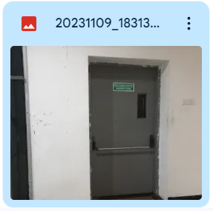
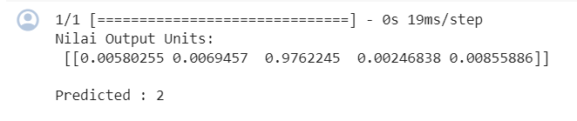

Slide 10
Menentukan nilai output (hasil prediksi). Penentuan kelas yaitu berdasarkan nilai prediksi tertinggi
from keras.preprocessing.image import img_to_array, load_img
import numpy as np
img = load_img(test_dir+'/20231109_183454.jpg', False, target_size=(100,50))
x = img_to_array(img)
x = np.expand_dims(x, axis=0)
preds = model.predict(x)
print("Nilai Output Units:\n", preds)
index_preds = np.argmax(preds)
print("\nPredicted :", index_preds)

Slide 11
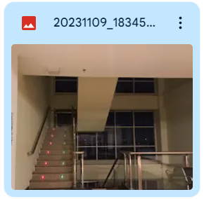
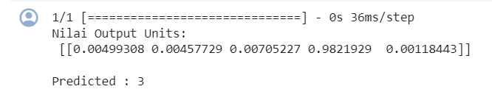

Slide 12
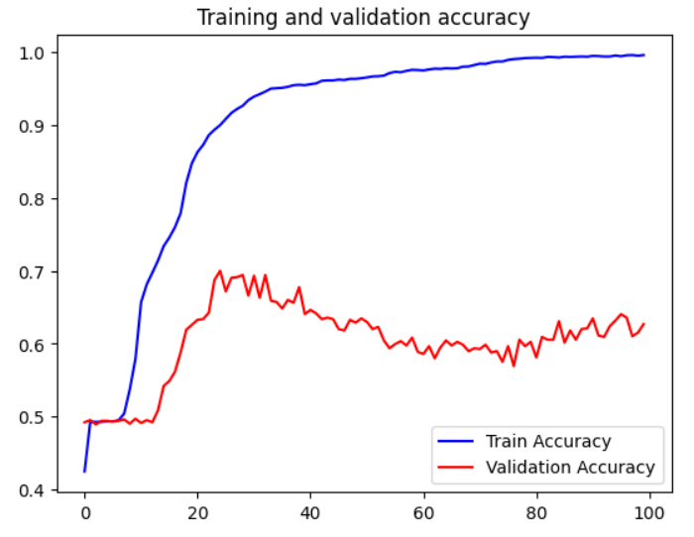
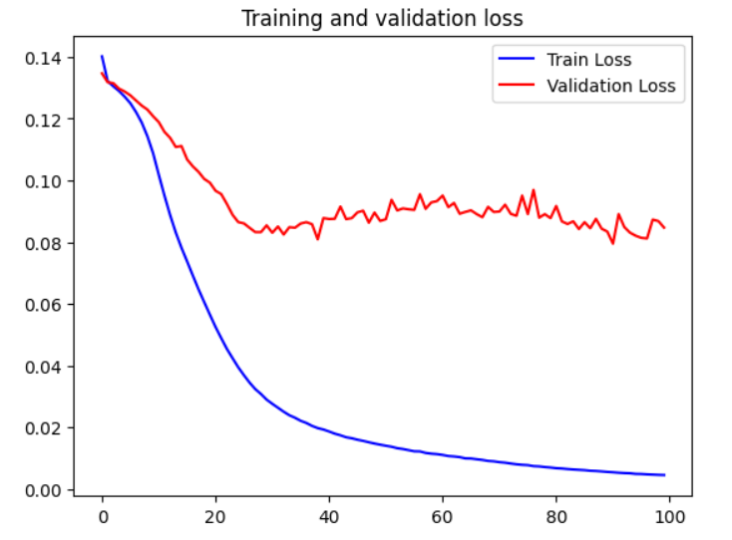
Hasil (Perbandingan dataset sebelumnya dengan dataset saat ini)
Dataset Sebelumnya

Slide 13
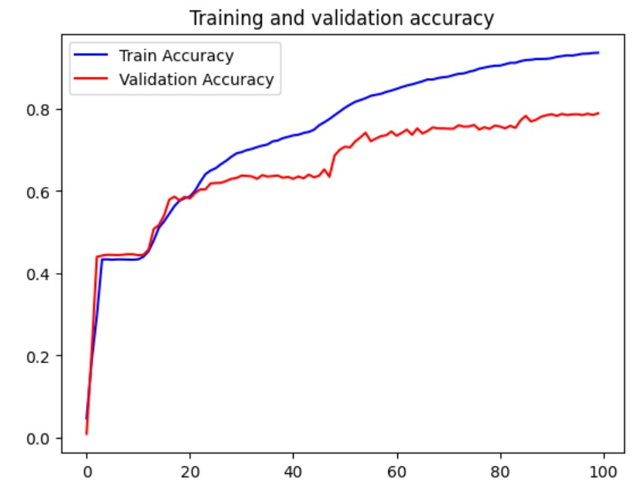
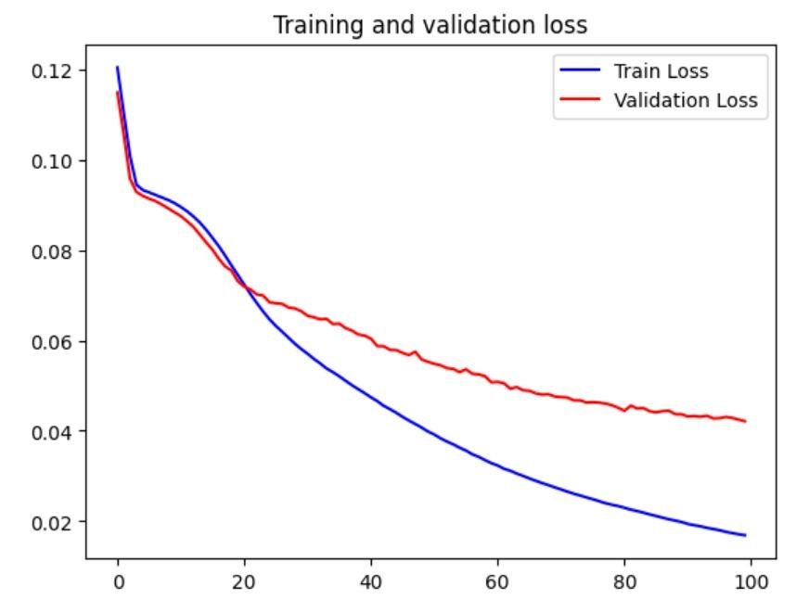
Dataset Kelas

Slide 14
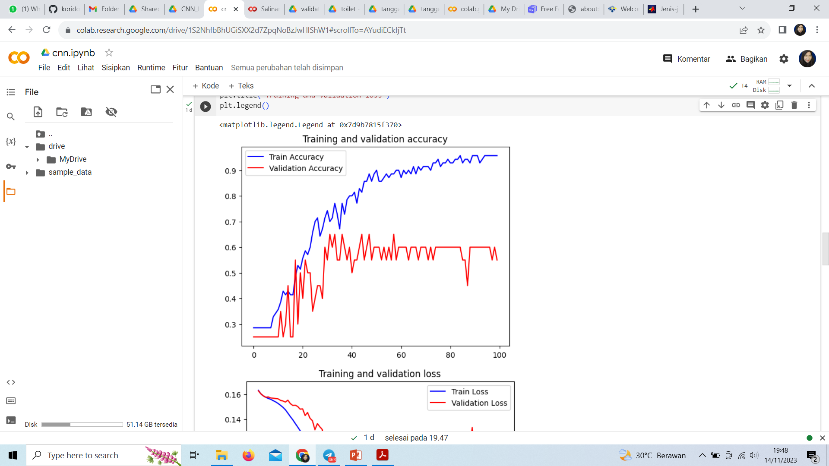
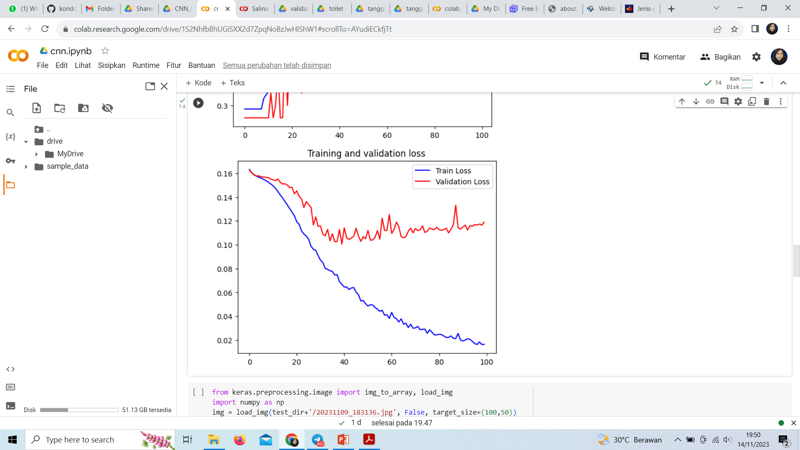
Dataset Kami

Slide 15
Percobaan ke 2 Menggunakan Yolo

Slide 16
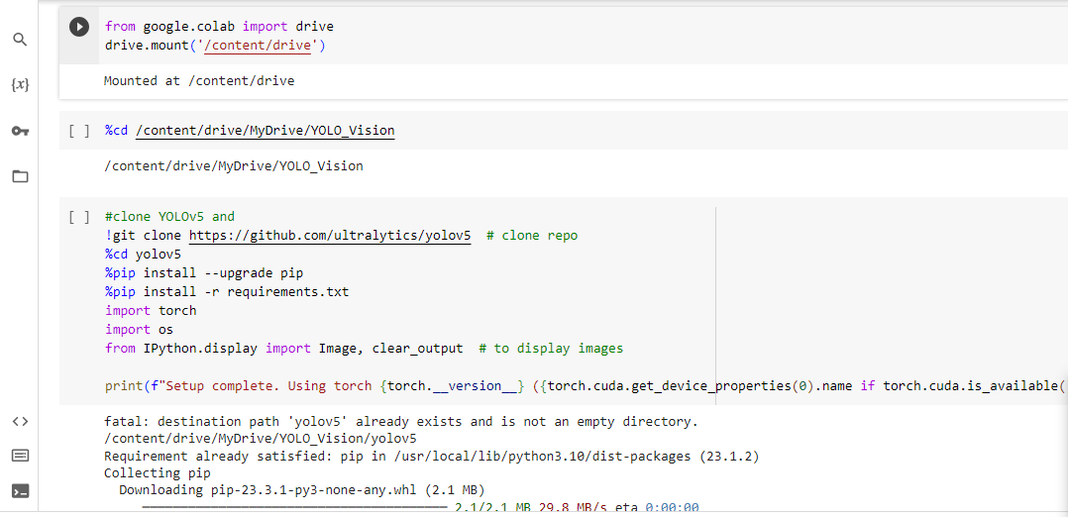
Processing Using Yolo

Slide 17
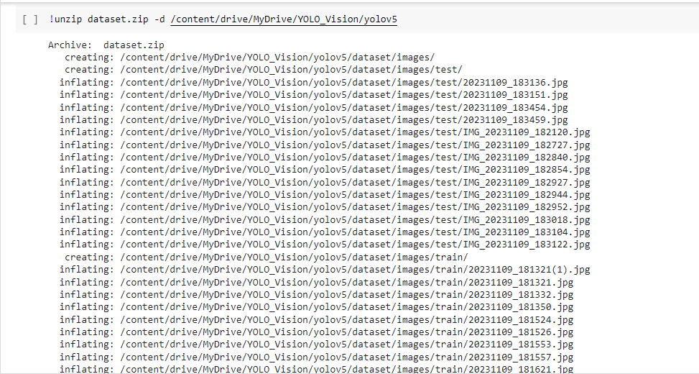
Processing Using Yolo

Slide 18
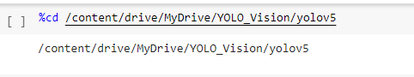
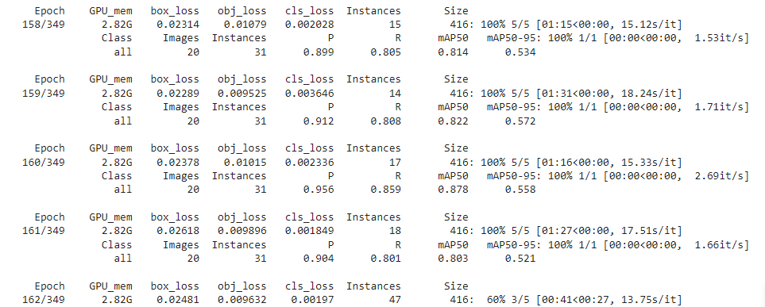
Processing Using Yolo

Slide 19
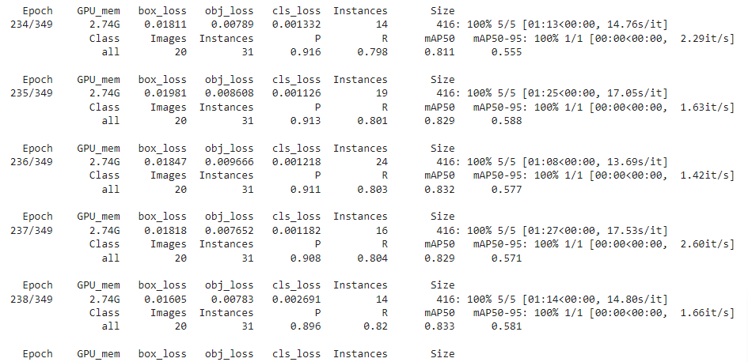
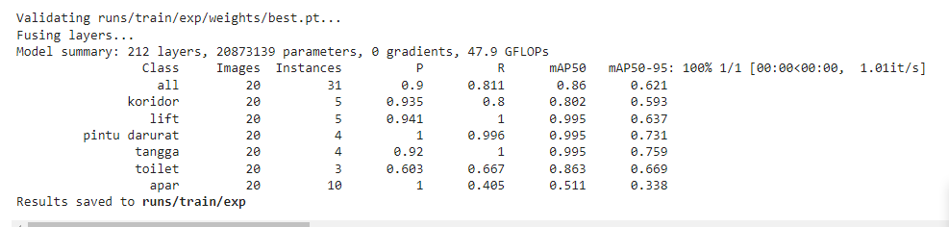
Result using yolo

Slide 20
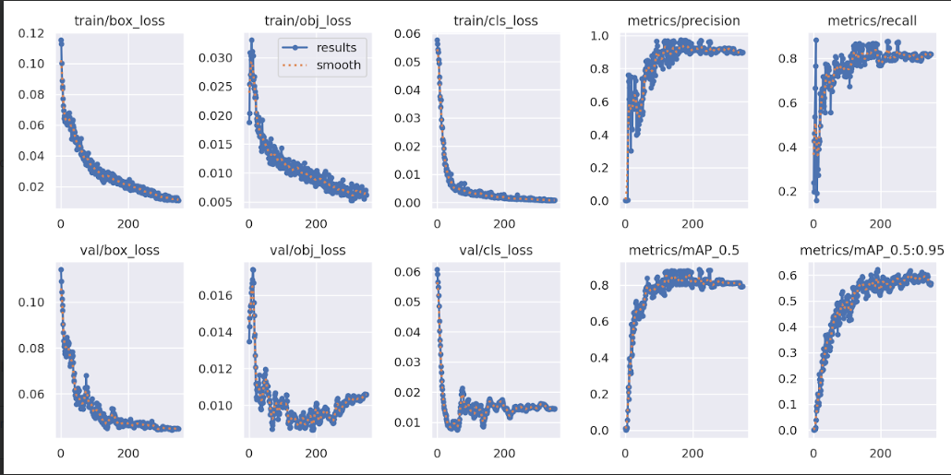
Result using yolo
Result with yolo

Slide 21
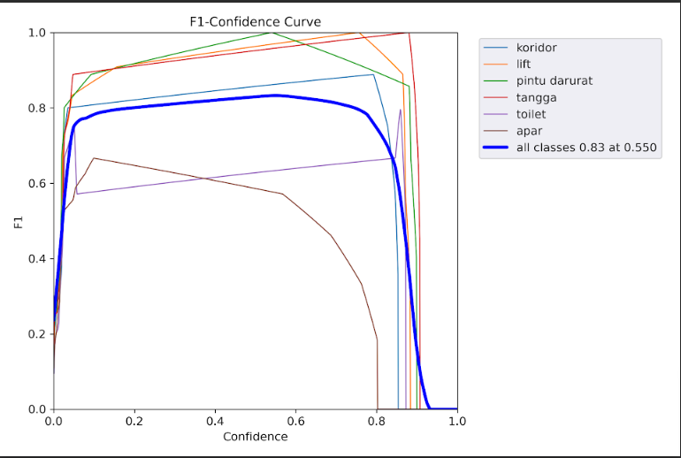
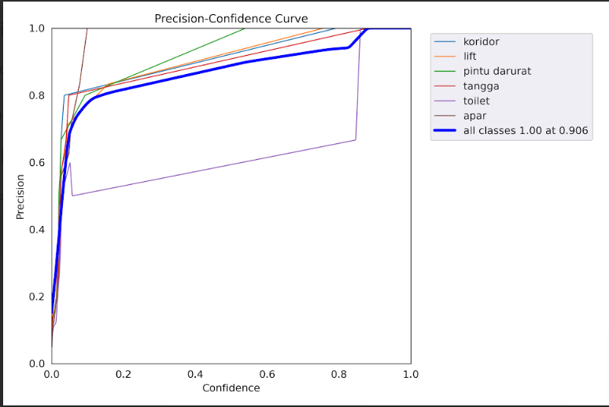
Result using yolo

Slide 22
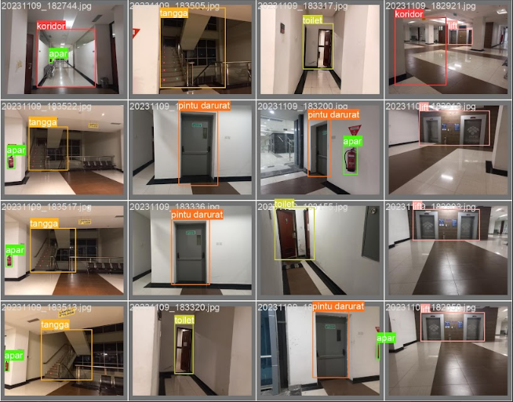
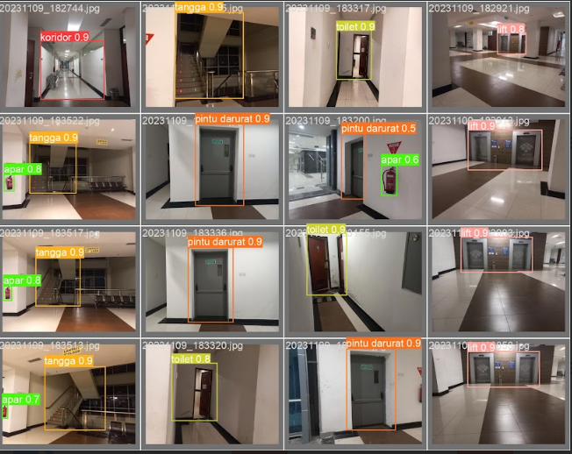
Result using yolo

Slide 23
Perbandingan dengan metode yang digunakan kelompok lain
Kelompok | Metode | Dataset yang digunakan | Loss | Hasil Akurasi
Kelompok 1 | CNN custom 2 layer | Ada 8 class names ['apar': 0, 'kelas': 1, 'koridor': 2, 'lift': 3, 'orang': 4, 'pintu_darurat': 5, 'pintu_ruang': 6, 'tangga': 7] | 0.0169 | 0.936
 | Yolo | Ada 6 class names: ["koridor", "lift", "pintu darurat", "tangga", "toilet", "apar"] | 0.0007749 | 0.83
Kelompok 2 | CNN custom | Ada 5 class names: ["koridor", "lift", "pintu darurat", "pintu_ruangan", "tangga”] | 0.02 | 0.98
Kelompok 3 | VGG16 | - | 0.0645 | 0.982

Slide 24
LinkCode cnncustom:https://colab.research.google.com/drive/17cvyHYcCU9Zd_8FAL6VYJLNl-Y6mBq2C?usp=drive_link yolo : https://colab.research.google.com/drive/1_9hkuF6cve2F_V_5QUblb-RFirSlYtTL#scrollTo=DZM4Mvp8j-gp

Slide 25
Link Youtube
https://youtu.be/3TIM57JCgXo

Slide 26
Terimakasih

